Slide 1
Software Testing Overview

Slide 2
Basic Testing Concepts
By the end of this module, you will be able to:
Define what is ‘Testing’
Articulate the challenges in Testing
Differentiate between Functional and Non Functional Testing
Explain Testing Techniques

Slide 3
Related words
ensure
working well
in good condition
examine
TEST
experiment
evaluate
demo
try
Notes:
Focus: The goal of testing is to ensure the business system meets the established functional and technical requirements.
Note to Instructor: Read and relate the bullets:
Bullet 1 pertains to ASSEMBLY TESTING
Bullet 2 pertains to PRODUCT TESTING
Bullet 3 pertains to PERFORMANCE TESTING
Bullet 4 pertains to USER ACCEPTANCE TESTING
Transition: Let’s take a look at what are the challenges of testing.

Slide 4
What is Software Testing?
It is process of verifying & validating a software application for the implicit & explicit user requirements for positive and negative test conditions.
Testing a software ensures:
The classes and components work correctly when integrated into a complete application.
The application meets product requirements and that all applications work together.
The application meets all the performance-related metrics, such as response time, availability, and capacity requirements.
The application meets stakeholder expectations.
Notes:
Focus: The goal of testing is to ensure the business system meets the established functional and technical requirements.
Note to Instructor: Read and relate the bullets:
Bullet 1 pertains to ASSEMBLY TESTING
Bullet 2 pertains to PRODUCT TESTING
Bullet 3 pertains to PERFORMANCE TESTING
Bullet 4 pertains to USER ACCEPTANCE TESTING
Transition: Let’s take a look at what are the challenges of testing.

Slide 5
Challenges of Testing
Some challenges of testing are:
Training in Testing
Building relationships with developers
Using tools
Getting managers to understand testing
Communicating with users about testing
Making necessary time for testing
Testing “over the wall” software
Trying to hit a moving target
Fighting a lose-lose situation
Having to say “no”

Slide 6
Common Test Types
Functional Testing:
Installation testing
Smoke testing
Configuration testing
Compatibility testing
Exception testing
Interface testing
Conversion testing
Non Functional Testing:
Performance testing
Load testing
Stress testing
Volume testing
Reliability testing
Security testing
Usability testing
Recoverability testing
Maintainability testing
Localization testing
Documentation testing
Data quality testing
Platform testing
Concurrency testing

Slide 7
What is Functional Testing?
Functional testing is concerned with the functional requirements and covers how well the system executes its functions. These include:
User commands
Data manipulation
Searches and business processes
User screens
Integrations

Slide 8
Functional Testing Requirements
The official definition for a functional requirement specifies what the system should do:
"A requirement specifies a function that a system or component must be able to perform."
Functional requirements specify specific behavior or functions, for example:
"Display the heart rate, blood pressure and temperature of a patient connected to the patient monitor."

Slide 9
Functional Testing Requirements
Typical functional requirements are:
Business Rules.
Transaction corrections, adjustments, cancellations.
Administrative functions.
Authentication.
Authorization –functions user is delegated to perform.
Audit Tracking.
External Interfaces.
Certification Requirements.
Reporting Requirements.
Historical Data.
Legal or Regulatory Requirements.

Slide 10
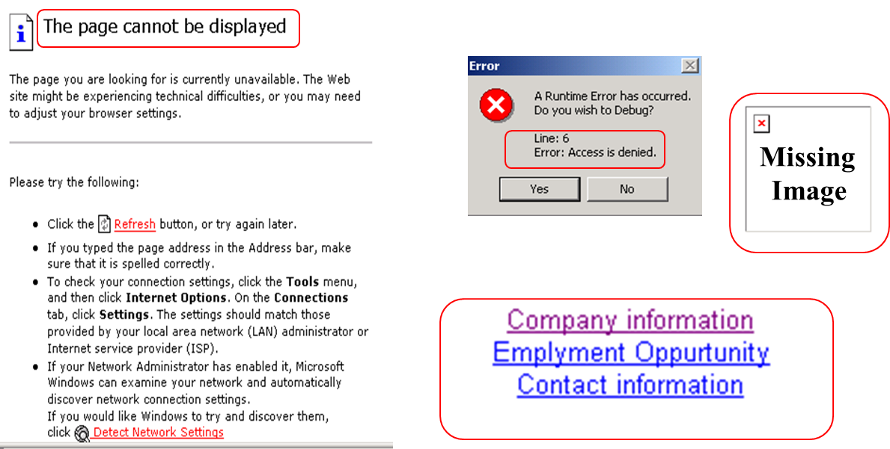
Why Functional Testing is important?

Slide 11
What is Non Functional Testing?
Non-functional testing is concerned with the non-functional requirements.
It is designed to evaluate the readiness of a system according to several criteria not covered by functional testing.
It enables the measurement and comparison of the testing of non-functional attributes of software systems.

Slide 12
Non-Functional Testing Requirements
The official definition for a non-functional requirement specifies how the system should behave:
"A non-functional requirement is a statement of how a system must behave, it is a constraint upon the systems behavior."
Non-functional requirements specify all the remaining requirements not covered by the functional requirements. They specify criteria that judge the operation of a system, rather than specific behaviors, for example:
"Display of the patient's vital signs must respond to a change in the patient's status within 2 seconds."

Slide 13
Non - Functional Testing Requirements
Typical Non-functional requirements are:
Performance – Response Time, Throughput, Utilization, Static Volumetric.
Scalability.
Capacity.
Availability.
Reliability.
Recoverability.
Maintainability.
Serviceability.
Security.
Regulatory.
Manageability.
Environmental.
Data Integrity.
Usability.

Slide 14
Performance Testing
What is it?
Why is so important?
What are the types of Performance Tests?
What is the difference between Load, Performance, and Stress Testing ?
What does Performance testing have to do with functional or non-functional testing?

Slide 15
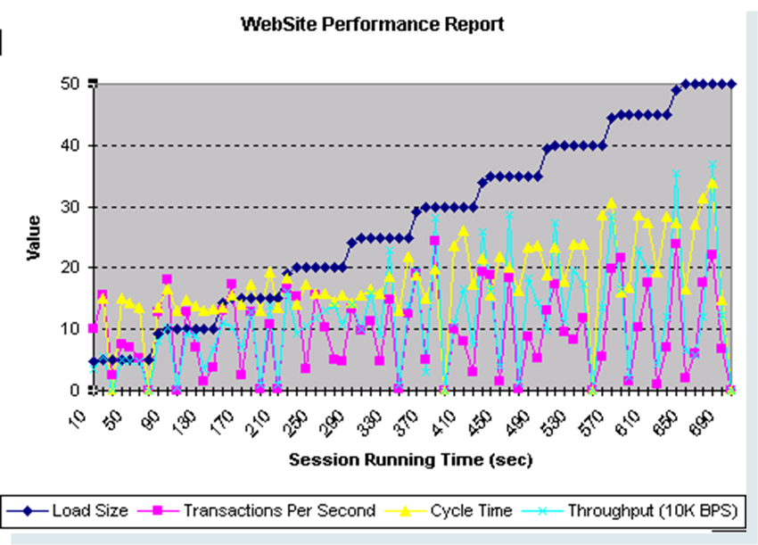
What is Performance Testing?
Performance Tests determine the runtime “behavior” of the application and its supporting infrastructure, under certain conditions.
Performance Testing is used to measure several system characteristics, such as:
Processing speed.
Response time.
Resource consumption.
Throughput.
Efficiency.

Slide 16

Why is Performance Testing important?
The week of Feb 6, 2000: Hackers delivered over 1-Billion transactions concurrently to each one of these sites.
Yahoo
eBay
Buy.com
Amazon
eTrade

Slide 17
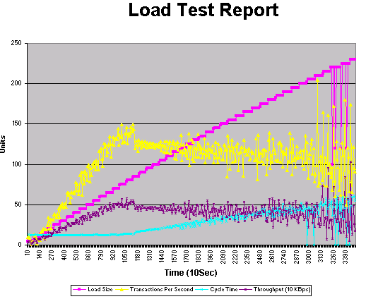
Performance Testing – Load Test
Load Tests determine the applications behavior under load, up to and including its limits (not just at its limits).
Load tests specifically refer to the load size (number of concurrent users) and related values.

Slide 18
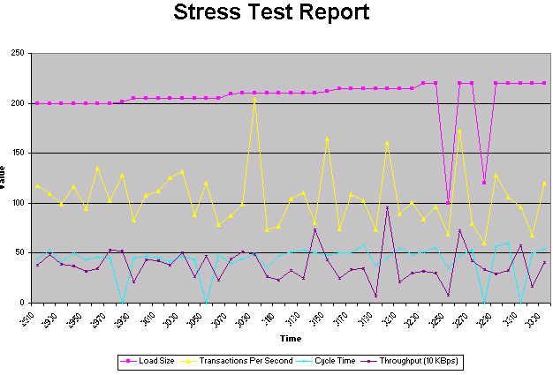
Performance Testing – Stress Test
Stress testing determines the applications ability to handle large amounts of data.
Stress testing can be much more successful with a full load applied to the server.
Running addition applications on the server in conjunction with the client side tests is an additional form of stress testing.

Slide 19
Testing Techniques
Black Box Testing
White Box Testing
Positive Testing
Negative Testing
Static Testing
Dynamic Testing

Slide 20
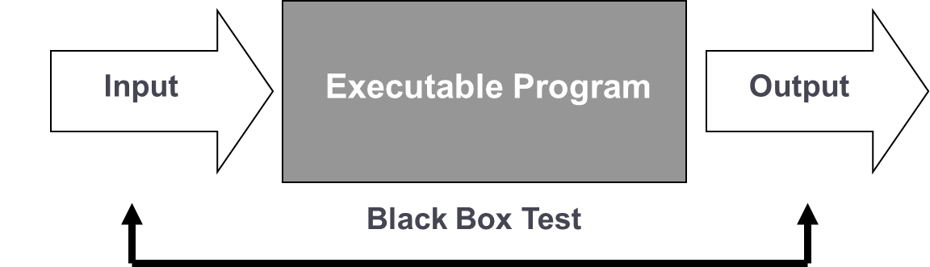
Black Box Testing (Functional Testing)
Black Box testing ignores the internal mechanism of a system or component and focuses solely on the outputs generated in response to selected inputs and execution conditions.
Notes:
Focus: What is Black Box Testing?
Note to Instructor: Read the content on the slide and embellish with the following:
Also known as functional testing. A testing technique whereby the internal workings of the item being tested are not known by the tester. For example, in a black box test on a software design the tester only knows the inputs and what the expected outcomes should be and not how the program arrives at those outputs. The tester does not ever examine the programming code and does not need any further knowledge of the program other than its specifications.
Transition: Next, we will look at the advantages and disadvantages of Black Box testing.

Slide 21
Black Box Testing
Advantages:
Tester needs no knowledge of implementation, including specific programming languages. Tester and programmer are independent of each other.
Tests are done from a user’s point of view.
Test cases can be designed as soon as the specifications are complete.
Disadvantages:
Only a small number of possible inputs can actually be tested, to test every possible input stream would take nearly forever.
Without clear and concise specifications, test cases are hard to design.
There may be unnecessary repetition of test inputs if the tester is not informed of test cases the programmer has already tried.
May leave many program paths untested.

Slide 22
White Box Testing (Structural Testing)
White Box testing takes into account the internal mechanism of a system or component.
Requires programming skills to identify all paths through the software.
The tester chooses test case inputs to exercise paths through the code and determines the appropriate outputs.
The test is accurate only if the tester knows what the program is supposed to do. He or she can then see if the program diverges from its intended goal.
White box testing does not account for errors caused by omission.
All visible code must also be readable.
Notes:
Focus: What is White Box Testing?
Note to Instructor: Read the content on the slide and embellish with the following:
White box testing is also called structural or open box testing.
In white box testing, the tester has to deal with the code and hence needs to possess knowledge of coding and logic, i.e., the internal working of the code.
A white box test also needs the tester to look into the code and find out which unit/statement/chunk of the code is malfunctioning
Transition: Next, we will review the advantages and disadvantages of white box testing.

Slide 23
White Box Testing
Advantages:
It is very easy to find out which type of input/data can help in testing the application effectively.
It helps in optimizing the code (e.g., it helps remove the extra lines of code, which can bring in hidden defects).
Disadvantages:
A skilled tester is needed to carry out this type of testing, which increases the cost.
It is nearly impossible to look into every bit of code to find hidden errors, which may create problems and result in the failure of the application.
Notes:
Focus: What is White Box Testing?
Content: Highlight the advantages and disadvantages of White Box Testing
Advantages:
As the knowledge of internal coding structure is prerequisite, it becomes very easy to find out which type of input/data can help in testing the application effectively.
The other advantage of white box testing is that it helps in optimizing the code iii) it helps in removing the extra lines of code, which can bring in hidden defects.
Disadvantages:
As knowledge of code and internal structure is a prerequisite, a skilled tester is needed to carry out this type of testing, which increases the cost.
And it is nearly impossible to look into every bit of code to find out hidden errors, which may create problems, resulting in failure of the application.
Transition: Next, we will take a look at Positive Testing.

Slide 24
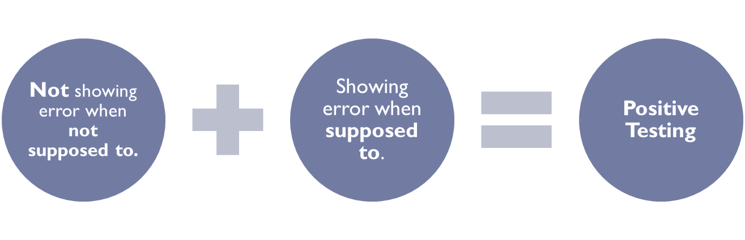
Positive Testing
Aimed at showing that the software works.
Testing the system by providing valid data.
Also known as "test to pass".
Notes:
Focus: What is Positive Testing?
Note to Instructor: Read the content on the slide and embellish with the following:
Positive testing is testing that attempts to show that a given module of an application does what it is supposed to do.
Testing the system by providing valid data
So if either of the situations above occur, you have a positive test in terms of its result – not what the test was hoping to find. The application did what it was supposed to do.
Transition: Next, we will take a look at Negative Testing.

Slide 25
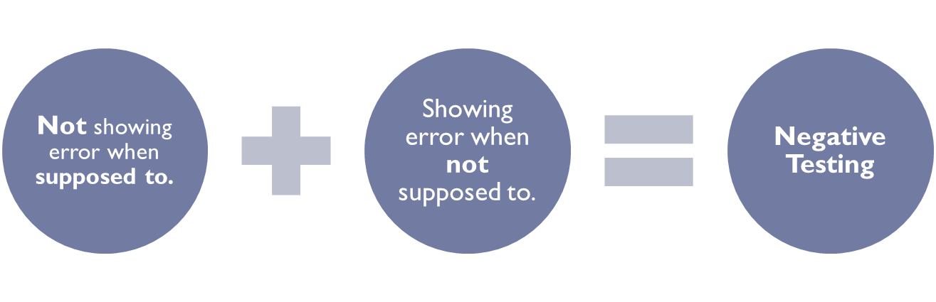
Negative Testing
Testing aimed at showing software does not work.
Testing the system by providing invalid data.
Also known as "test to fail".
Notes:
Focus: What is Negative Testing?
Note to Instructor: Read the content on the slide and embellish with the following:
Negative testing is testing that attempts to show that the module does not do anything that it is not supposed to do.
Testing the system by providing invalid data
If either of the situations in above occur, you have a negative test in terms of its result – again, not what the test was hoping to find. The application did what it was not supposed to do.
Transition: Next, we will take a look at Static Testing.

Slide 26
Static Testing
Static Testing (also known as "Dry Run Testing") is a form of testing where the software isn't actually used.
Syntax checking and manually reading the code to find errors are methods of static testing. This type of testing is mostly used by the developers.
'Static testing' is generally not taken as detailed testing, but checks mainly for the sanity of the code/algorithm, and to assess if the program is ready for more detailed testing, where methods like code review, inspection and walkthrough are used.
Static testing can be done before compilation.
Notes:
Focus: What is Static Testing?
Note to Instructor: Read the content on the slide and embellish with the following:
Static Testing is a form of testing where the software isn't actually used. It is generally not detailed testing, but checks mainly for the sanity of the code, algorithm, or document.
This type of testing can be used by the developer who wrote the code, in isolation. Code reviews, inspections and walkthroughs are also used.
Static testing involves review of requirements or specifications. This is done with an eye toward completeness or appropriateness for the task at hand.
Static testing is about prevention.
Transition: Next, we will take a look at Dynamic Testing.

Slide 27
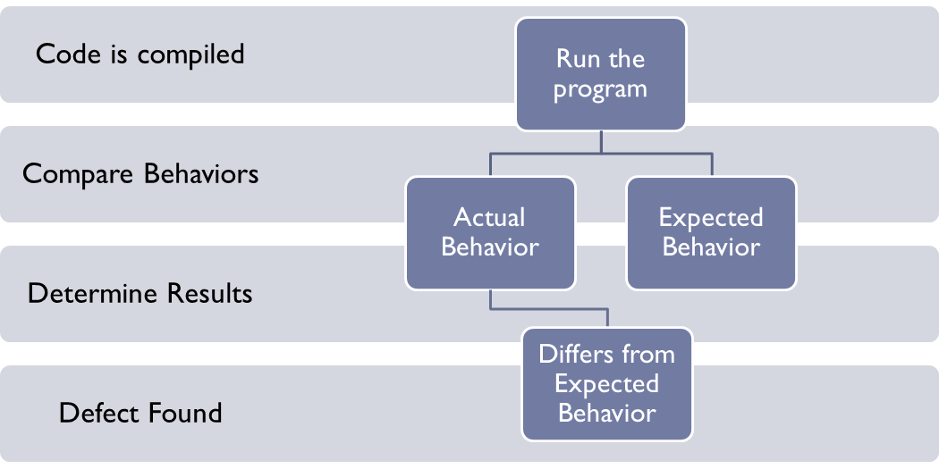
Dynamic Testing
Dynamic Testing involves working with the software, giving input values and checking if the output is as expected.
Dynamic testing can take place only after compilation. It won’t run otherwise.
Notes:
Focus: Dynamic testing consists of running a program and comparing its actual behavior to what is expected. If the actual behavior differs from the expected behavior, a defect has been found.
What is Dynamic Testing?
Note to Instructor: Read the content on the slide and embellish with the following:
Dynamic Testing involves working with the software, giving input values and checking if the output is as expected.
Test activities that involve operating the software are called dynamic testing.
Transition: Let’s discuss any questions that you may have on this topic.

Slide 28
Thanks

